Slide 1
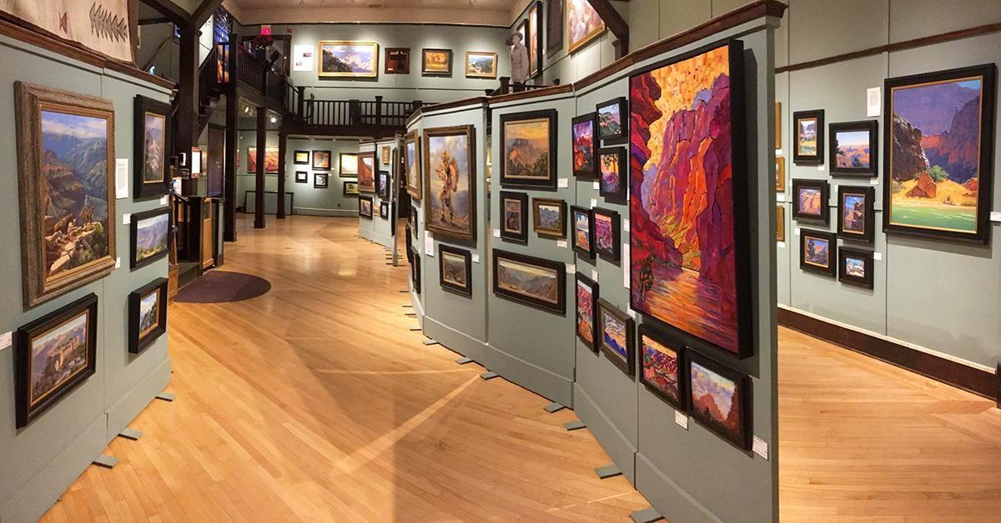
Art Exhibition Management System
Spring 2026 CS 442
Group 12
Brian Daza Aditi Ghosh Abrar Makki

Slide 2
AEMS
Content
About the Project
Practices
Demo
SP 26
Next
Relevant characteristics of the project
Software engineering practices and tools applied throughout the semester
Live demonstration of the application

Slide 3
AEMS
Art Exhibition Management System
SP 26
About
Art Exhibition Management System (AEMS) is a web-based application designed to streamline the management of art exhibitions.
It enables users to explore artworks, purchase items, and interact with exhibitions, while providing administrators with tools to manage artworks, customers, and orders efficiently.
Characteristics
The management system consists of Role-based system (Admin & Customer dashboards)
Real-time artwork browsing and purchasing
Centralized management of artworks, orders, and exhibitions
Interactive UI with modern design and 3D artwork support
Tech Stack
Frontend: React, Typescript, MUI, CSS3, HTML5
Backend & Database: : Django, Python, SQLite
External APIs: Art Institute of Chicago API, SerpAPI

Slide 4
AEMS
Software Engineering Practices
Implemented Software Engineering Practices
Practices
XP
Pair programming
Small releases
Collective code
Scrum
Weekly meetings
Tools
Jira (Kanban)
VSCode
Version Control
GitHub
SP 26

Slide 5
AEMS
Live Demo
SP 26

Slide 6
Thank you

